Slide 1

Pneumonia detection in chest X-rays using CNN and transfer learning
Name :- D. SHRUTHI
ROLL NO :- MDM18b013

Slide 2
PROBLEM STATEMENT
Pneumonia is an infection that inflames the air sacs in one or both lungs.
The air sacs may fill with fluid or pus (purulent material), causing cough with phlegm or pus, fever, chills, and difficulty breathing.
A variety of organisms, including bacteria, viruses and fungi, can cause pneumonia.
For every 100,000 children, over 1400 get infected with pneumonia.
It is difficult to diagnose many lung disorders due to limited availability of trained specialists in hospitals. While pneumonia diagnoses are often validated by a single physician, leaving margin of error, our approaches may be viewed as both ways of confirmation mechanism.

Slide 3
Proposed solution
The main objective of this project is to filter out a person whether infected by pneumonia or not using chest X-rays.
We created a simplified model architecture based on VGG with less layers for this project. Chest X-rays used to detect pneumonia must be evaluated by radiation doctors
The decision support system makes a diagnosis based on chest X-ray pictures, which is subsequently validated by the attending physician, reducing both human and machine error.

Slide 4
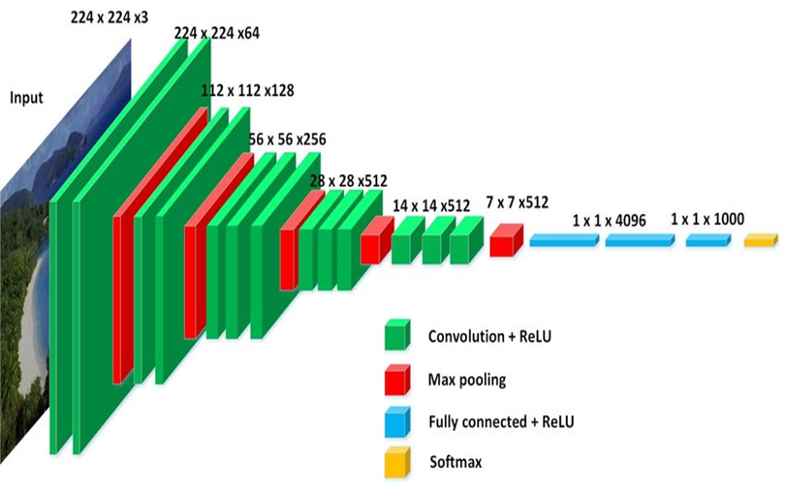
Methodology
CNN Architecture
3 stages for implementation
Data preprocessing
Model training
Model evaluation

Slide 5
Data preprocessing
We took 5288 images from Kaggle website. In this stage we are actually doing two process namely data training and data testing.
In this about 82 no of batches are under data training set and 10 sets are used for data testing with a batch size of 64 images. That means 5248 images were used for data training and 640 images are for testing.
To reduce calculation and speed up processing, the original 3-channel pictures will be shrunk from 1024*1024 to 224*224 pixels in this stage.

Slide 6
MODEL TRAINING
The training will be done with random samples that we took from Kaggle website. Those samples will be used as the foundation for the generator, which will generate a new picture with some random alterations using Adam optmizer.
This generator will create unique images at each epoch, allowing our neural network learner to better identify samples in the test set. And this is how the training process will work.

Slide 7
Model EVALUATION
After training the mode, the model is evaluated on the test data.
The confusion matrix offers information about the mistake created by the classifier.
Precision = (TP + FP)/(TP + FP)
Recall = TP /(TP + FN)
F1 score = (2*Precision * Recall)/(Precision + Recall)
Accuracy= TP + FN)/ (TP + TF + FP + FN)

Slide 8
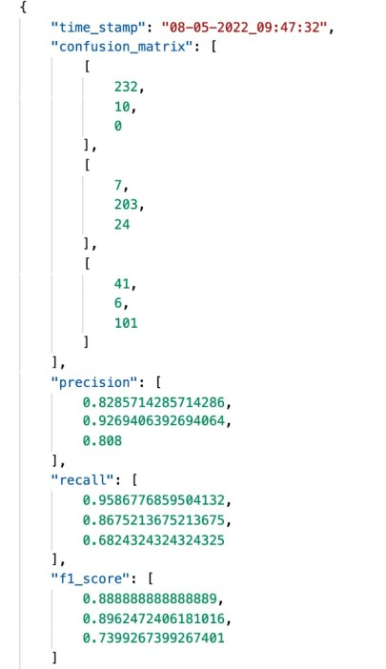
Model evaluation result:-
Normal and bacterial pneumonia images, viral pneumonia and normal images and bacterial and viral pneumonia images respectively had classification precision, recall, and f1 score of 82%, 92%, and 80%; 95%, 86%, and 68%; and 88.8%, 89.6%, and 73.9%.

Slide 9
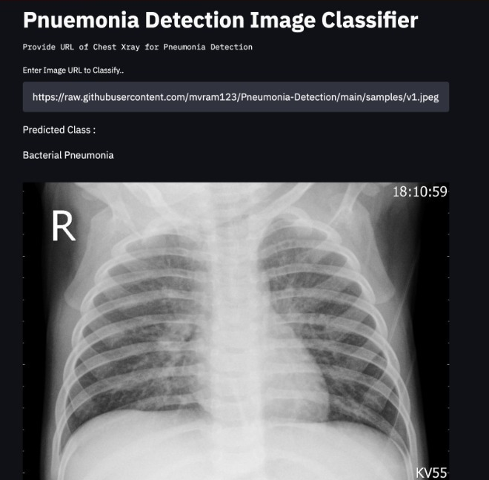
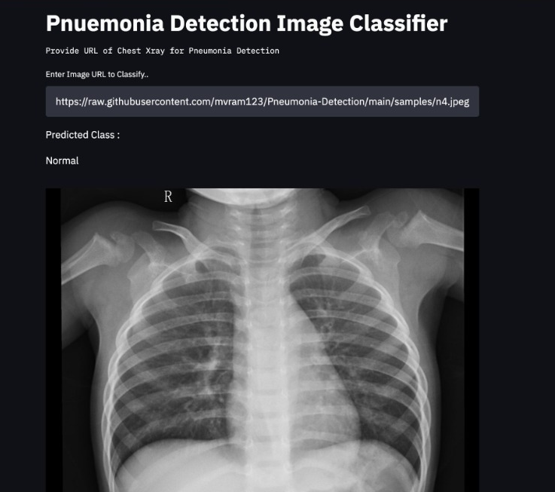
OUTPUT:-
Bacterial pneumonia
Normal

Slide 10
Conclusion :-
Our project describes a deep-CNN-based transfer learning using chest x-ray images and test data we built a model and this will classify and differentiate normal and pneumonia patients
The model that we developed has validation loss of 45.66% and validation accuracy of 85.90%. As a result, our model has outperformed since it has a better value.
Our findings imply that these approaches can be utilised to enhance diagnosis over traditional methods, perhaps improving treatment quality.

